Slide 1
Multimedia Communication System

Slide 2
Communication Aspect
Multimedia applications have several requirements – as well for the data transmission as for controlling interactivity
For structuring control and transmission functionality and implement common protocols: make a distinction to two system components Application Subsystem and Transport Subsystem

Slide 3
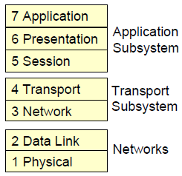
Communication Aspects
1. Application Subsystem
Responsible for the management and service issues for group cooperation and session orchestration
Supporting a large scale of multimedia applications, e.g.
Multimedia Mail
Virtual Reality Applications
Video Conferencing
CSCW (Computer Supported Cooperative Work)
2. Transport Subsystem
Transport and network layer protocols for multimedia applications (streaming)

Slide 4
Application Subsystem
Streaming multimedia data often is used in cooperative computing
Beneath streaming services (transport subsystem), some control functionality for cooperation support is needed
Cooperative Computing is generally known as Computer Supported Cooperative Work (CSCW).
Applications or Tools for cooperative computing:
Electronic mail
Shared whiteboards
Screen sharing tools
Application sharing
Text-based conferencing systems (MS Messenger)
Desktop teleconferencing (NetMeeting)
Video conference systems (e.g. MBone Tools, ProShare from Intel, PictureTel, Teles Online, NetMeeting from Microsoft)

Slide 5
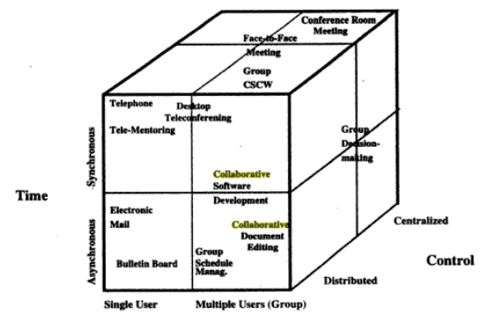
Cooperation Dimensions
Computer-Supported cooperation may be Classified according to the following parameters:
Time
Asynchronous cooperative work (not at the same time)
Synchronous cooperative work (at the same time)
User Scale
Single user, two users (“dialogue, point to point“, direct cooperation) or groups with more than two users
Static or dynamic groups, depending on if the members are pre-determined or not
Control
Centralized, i.e. controlled by a “chairman”
Distributed, i.e. control protocols provide consistent cooperation
Locality
Cooperation at the same place
Tele-cooperation of users at different places

Slide 6
Cooperation Operation
Cooperation-transparent systems
Existing applications are extended for cooperation (Single user document editors expanded for simultaneous editing of a shared document among several users, e.g. some text processors)
Cooperation-aware systems
Dedicated software application for CSCW (e.g. Lotus Notes, conferencing systems)

Slide 7
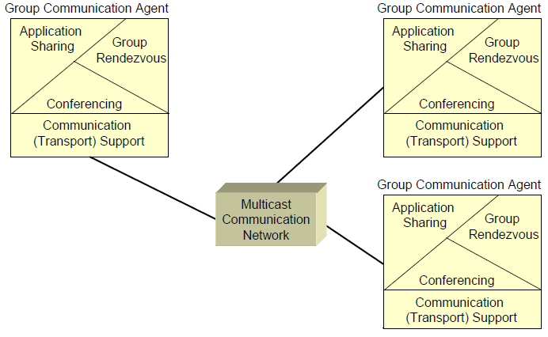
Group Communication Architecture
Communication of multiple users in a synchronous or an asynchronous mode with centralized or distributed control

Slide 8
Group Communication Architecture
GCA consists of
Support Model:
It consists of Group communication agents cooperating via a multicast network. GC Agents uses following for collaborations:
Group rendezvous (organization of meetings and delivering information)
Shared applications (simultaneous replication and modification of information to multiple users e.g. tele-pointing, joint editing)
Conferencing (audio/video)
System Model:
Client/server model
Interface Model:
Exchanging information within the support model (object oriented)

Slide 9
Group Communication Architecture
Clients:
User interfaces supporting interaction between group members and the system
User Protocols: Between the clients, e.g.
Open, close, dynamically join or leave a meeting
Floor passing (Floor = kind of token held by the participant currently performing an action)
Servers:
Specialized servers for different tasks of the group communication work, e.g.
Directory server (for group rendezvous services)
Application sharing server
Conference server
Multimedia server (for intermedia synchronization)
Group Work Management Protocols: Between the clients and the servers, e.g.
Registration of meetings
Queries for information about meetings

Slide 10
Group Rendezvous
Setting up a group and delivering information about groups and meetings:
Synchronous Rendezvous Methods:
Explicit invitations (point-to-point or point-to-multipoint)
Initiator of a meeting has to know where users reside
Using directory services (X.500) as a knowledge base with information about the meeting, e.g.
Name of the meeting/conference
Registered or authorized participants
Role of participants
Asynchronous Rendezvous Methods:
Using e-mail
Using bulletin boards (local bulletin boards or World Wide Web)
Simple Conference Announcement Protocol (SCAP)

Slide 11
Application Sharing
Application Sharing enables a cooperative work: several users are working at the same time on the same document at different places:
Shared objects (documents) are displayed in shared windows
Shared application program (e.g. word processor) executes input from a participant
Modifications of the document are distributed among all participants
Consistency of shared objects has to be guaranteed
Floor passing control has to be provided
Application Sharing can be realized centralized or distributed (i.e. replicated)

Slide 12
Application Sharing
Centralized
A single copy of the shared application is available and runs at one site only
All input is forwarded to that site
Output (shared document) is distributed to all sites
Only one participant at a time is having control
+ Easy consistency maintenance (only one copy of the application)
− High network traffic (for output distribution)
− Relatively unreliable (if central site is overloaded or fails then everything is down)
Replicated
A copy of the shared application runs locally at each site
Input is distributed to all sites
+ Low network traffic and response times (only input distribution to all sites is necessary) apart from the significant traffic arising from consistency maintenance
− Difficult consistency maintenance

Slide 13
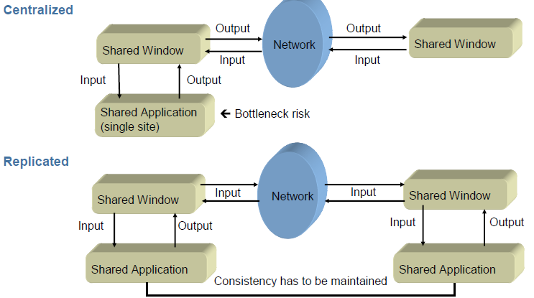
Application Sharing Architecture

Slide 14
Application Sharing
For both architectures, consistency of shared documents has to be maintained, e.g. by:
Centralized locks
Dependency detection
Floor passing control
Floor Passing Control
Only the floor holder has right to manipulate shared documents in shared windows, e.g. to perform the following operations:
Open or close shared windows
Load a document into a shared window
Give input to shared application
Necessary: control protocol for managing and passing on the floor; it checks whether the active site is floor holder
Floor holder accepts and processes inputs; distributes results to other sites
No floor holders: discards its own inputs; accepts input which comes from other sites

Slide 15
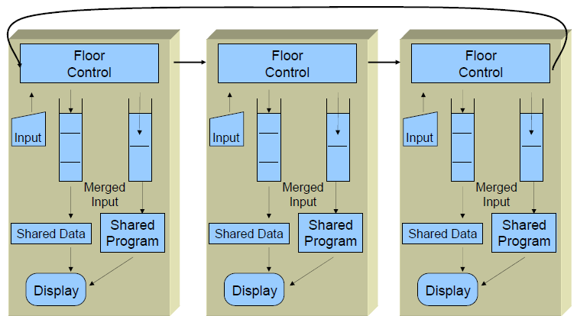
Application Sharing Architecture

Slide 16
Audio/Video Conferencing
Audio/video conferencing denotes a management service which controls simultaneous face-to-face communication between multiple users using multiple media (video, audio, text etc.)
Video:
Distinction between several scenarios with different number of active conference participants (all, a few, speaker or moderator only)
Large video walls with multiple high-resolution screens may be used especially for
Conferences with more than four participants
Display of view-graphs, images, animations etc.
Audio (true full-duplex high-quality communication with echo cancellation):
Used for discussions
Important for clarifying visual information
Maybe application sharing etc. for cooperative work during the conference
Important part of A/V conferencing: session management

Slide 17
Transport Subsystem
Multimedia applications have high requirements on network protocols:
1. High data throughput
Deliver as much data as possible in short time
2. Fast data forwarding
Deliver data as fast as possible
3. Service guarantees
Deliver data with regard to negotiated policies (throughput, delay)
4. Multicasting
1:n and m:n point communication
[a:b denotes: a senders and b receivers]
Needed: special transport resp. network protocols

Slide 18
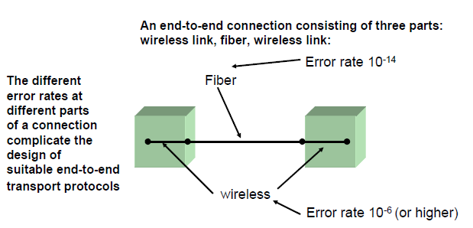
Transport Subsystem
Most transport protocols are designed for unreliable and “relatively slow“ networks
Modern high speed networks need new transport protocols that take into account the properties of this new network technology

Slide 19
Data Throughput
Audio and video data typically have a stream-like behavior
Even in compressed mode, they demand high data throughput (16 kbit/s for compressed audio, 64 kbit/s for original PCM-audio, 2 Mbit/s for MPEG-coded video)
In a workstation or in a network several of those streams may coexist
Telephone services or video conferencing demand real-time computing of the data streams
This requires not only suitable transport protocols, but also high performance workstations which are able to compute several multimedia streams simultaneously and can transmit the packets in appropriate speed to the network interface

Slide 20
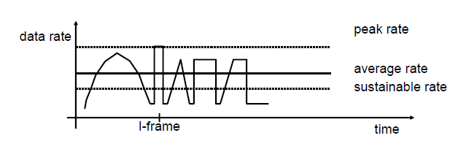
Data Throughput
If the allocated capacity is too low at a given time:
1. Maybe buffering will help
2. Graceful degradation of quality; e.g.
skip on more B-frames in an MPEG stream
reduce color depth
reduce frames rate

Slide 21
Fast Data Forwarding
End-to-end delay is limited by the speed of light but also by the intermediate network nodes (routers)
Different applications require data transfer ranging from “normal” error free data transmission up to time-constrained traffic
Real time communication demands low end-to-end delays – typically less than 200 msec – and low jitter
Fast data delivering forces intelligent acknowledgment mechanisms, because send-and-wait strategies are not suitable
Error free data delivery and real time communication requirements are difficult to grant at the same time, because error free data delivering forces data retransmission which will lead to high delays and large jitters!
→ This requires fast delivery services from the network and intelligent protocols which transmit only necessary traffic!

Slide 22
Service Guarantees/ Multicasting
Service guarantees
Service guarantees are important for the acceptance of multimedia applications
Multimedia applications need guarantees, such as: throughput ≥ minvalue, delay ≤ maxvalue1, jitter ≤ maxvalue2
To give service guarantees, resource management must be used – without this, in end-systems and switches/routers multimedia systems cannot provide reliable QoS to their users because transmission over unreserved resources may lead to dropping or delaying of packets
Multicasting
Multicasting is important for multimedia applications in terms of sharing resources like the network bandwidth
Many multimedia applications, such as video conferencing, have multicast characteristics

Slide 23
Transport Subsystem
Multimedia applications generate and consume a huge amount of data. They produce high demands for the underlying infrastructure and communication architecture:
Data should be copied directly from adapter to adapter to reduce copy overhead, e.g. from the video board to the network interface by using direct memory access (DMA). With DMA technique, the application itself never really touches the data, it only sets the correct switches for the data flow by connecting sources to sinks
The data transfer involved by the layered structure of the protocols form a bottleneck, hence other mechanisms must be found
For error-recovery some protocols use retransmission techniques which impose requirements on buffer space for queues at the expense of larger end-to-end delays
The synchronous behavior of most multimedia data streams must be mapped onto the asynchronous transfer mode of the underlying networks
Are the “old“ transport protocols like TCP and UDP suitable for multimedia transmission and, if not, which new protocols exist or have to be developed?

Slide 24
Quality of Service
Multimedia streaming has certain demands to the delivery of the data; the most important parameters are:
Throughput (bits/s)
Which minimum/maximum/average data rate is necessary?
Transmission delay (ms)
Which maximum delay is tolerable?
Jitter (ms)
Which fluctuations in the transmission delay are tolerable?
Availability (%)
With which probability the communication service is available?
Different application have different requirements to those parameters

Slide 25
Basic Concepts
ISO has defined parameterization of the services via QoS.
ISO has defined QoS as a concept for specifying how “good” the offered networking services.

Slide 26
MCS layer with QoS
Traditional QoS was provided by network layer of Communication System.
Enhanced Qos is achieved via adding QoS at transport services.
Layered model of MCS with QoS : three layers : application , system, and devices.
Above layer may or may not have human user and if posses QoS specification also resides.
User
User QoS
Application
Application QoS
System
(Operating and Communication System)
System QoS
MM Device QoS
Network QoS
Network
MM Devices

Slide 27
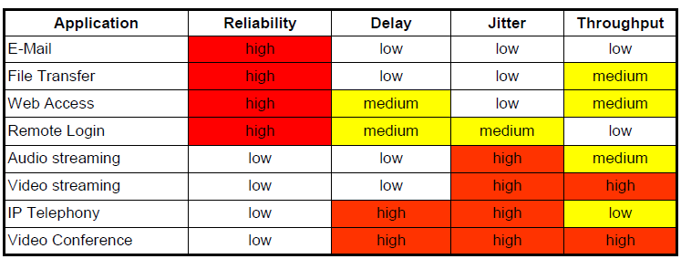
Quality of Service
high – medium – low: requirements to the QoS parameter by the application
yellow: critical parameters; a certain degree of fulfillment of the application’s requirement is
needed for good application usage, but problems could be tolerated for a short time
red: highly critical parameters; if the requirement is not fulfilled, usage is not possible

Slide 28
Translation of QoS Parameters
QoS parameters like before are network specific parameters; an application works with more abstract terms – during connection establishment, translation between layers is necessary:
Translation „Human Interface“ – „Application QoS“
Tuning service provides Graphical User Interface (GUI) for input/output of application QoS
Translation „Application QoS“ – „System QoS“
Translates video frame size to network packet size
May be connected with segmentation/reassembly functions
Translation „System QoS“ – „Network QoS“
Maps system QoS (e.g. packet end-to-end delay) to the network QoS parameters (e.g. end-to-end delay of cells in ATM networks)
Translation is bidirectional. This can cause problems:
Example: Video rate and video frame size determine the throughput for the network. Thus a throughput reduction may result in either lowering the quality of the image or the rate of successive images.

Slide 29
Scaling
Scaling is used for adapting a stream to available resources
Subsample a data stream to present a fraction of its original contents
Transparent scaling: can be applied independently from upper protocol layers, e.g. by dropping some identifiable portions of the data stream
Non-transparent scaling: requires interactions of the transport system with upper layers, e.g. modification of some coding algorithm parameters or recording in a different format.
Scaling can be applied to audio and to video data:
Transparent scaling is not good for audio, because presenting a fraction is easily noticed by the human listener
→ Non-transparent scaling, e.g. by changing the sampling rate is preferred for audio
For video, the suitable scaling method depends on the compression methods:
Temporal scaling reduces number of transmitted video frames, best suited for video with individual self-contained frames
Spatial scaling reduces number of pixels of each image
Frequency scaling reduces the number of DCT coefficients in coding algorithm
Amplitude scaling reduces the color depth by coarser quantization of the DCT coefficients

Slide 30
Resource
Active vs. passive resources (depending on their autonomous processing capabilities)
Active resources: CPU, network interface card, etc
Passive resources: file system, main memory, etc
Shared vs. exclusive resource usage
Active resource are usually allocated exclusively whereas passive ones can be shared by multiple tasks
Single vs. multiple resource occurrences
A “normal” workstation for a human user usually contains only a single CPU, whereas many servers contain two or more CPUs

Slide 31
Resource Management
Main goal of Resource Management: providing guaranteed delivery of multimedia data
→ Three main actions:
Reserve and allocate resources (end-to-end) during establishment (QoS negotiation, resource reservation)
Provide resources according to a QoS specification (Admission control, traffic shaping, scheduling)
Adapt to resource changes during data processing (Resource monitoring and adaptation)
Relations between QoS and resources:
QoS parameters ⇔ resource quantity allocated to the service and resource scheduling
→ Resource Management handles different mappings between QoS parameters and the corresponding resources

Slide 32
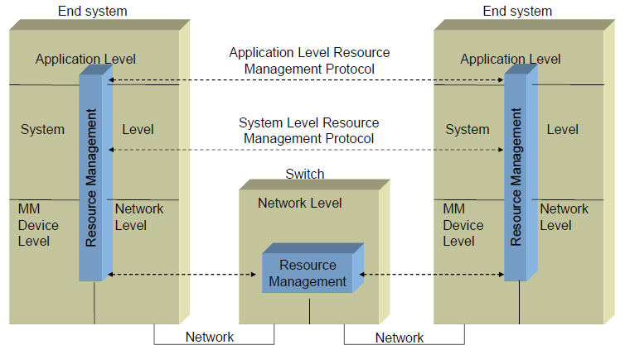
Resource Management

